Slide 1

Video capturing device identification
through block-based PRNU matching
Jian Li
Qilu University of Technology

Slide 2
CONTENTS
1
Research Background
2
Related works
3
Effect of Video Stabilization
4
Proposed Aglorithm
5
Experimental Results
6
Conclusion
Notes:
My report mainly consists of the above six parts:

Slide 3


1. Background - Motivation
Video capturing device identification (CDI) has been serving as a valuable tool for addressing cybersecurity concerns, such as multi-factor authentication and copyright protection
A promising technique for video CDI is to extract from a video distinguishable and unique traces left by its capturing device. The trace we analyze in this study is PRNU (photo-response non-uniformity) of the sensor of a capturing device

Slide 4
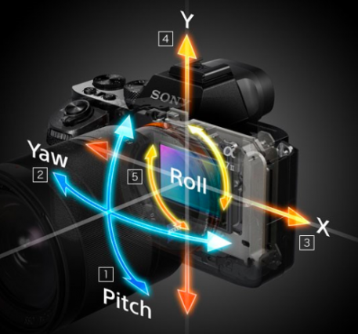
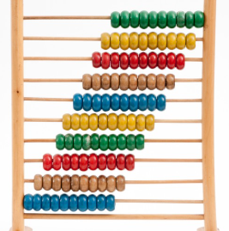
1. Background - Limitations of Prior Arts
The video stabilization procedure in a smartphone to align the shaking video content makes the PRNU in each frame misaligned. As a result, we cannot congregate enough source-matched signals to remove compression and some other influences on the PRNU extracted.
We can take registration for the PRNU within a video frame. Because we usually cannot know how each video frame is transformed, the re-alignment process involves a brute-force search of geometrical transformation parameters.
Notes:
Robustness is a key focus of video watermarking technology. Since watermarked videos may undergo complex transformations and malicious attacks, we aim to extract the watermark signal under any conditions to protect video copyrights from infringement.
To ensure robustness, watermarks must be embedded in specific video regions that remain intact after attacks or transformations. Traditionally, these regions are manually chosen, such as mid-to-low frequency areas. With deep learning, researchers now use neural networks to automatically select better embedding regions, enhancing watermark robustness and adapting to different video content.

Slide 5
CONTENTS
1
Research Background
2
Related works
3
Effect of Video Stabilization
4
Proposed Aglorithm
5
Experimental Results
6
Conclusion
Notes:
My report mainly consists of the above six parts:

Slide 6

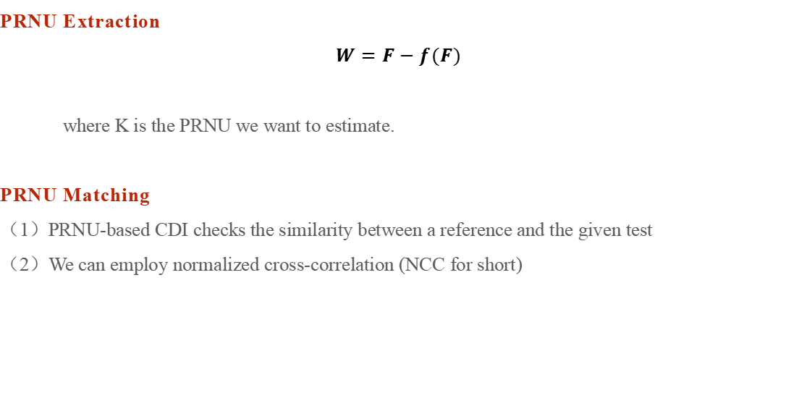
2.1 Related Works-Video PRNU extraction and matching
PRNU Extraction
$$W=F−f(F)$$
where K is the PRNU we want to estimate.
PRNU Matching
（1）PRNU-based CDI checks the similarity between a reference and the given test
（2）We can employ normalized cross-correlation (NCC for short)
Notes:
As a summary of this part, this paper primarily focuses on improving the robustness and imperceptibility of video watermarks. Optimizing watermark embedding and extraction processes through the use of attention mechanisms. This research aims to play a role in protecting intellectual property, ensuring content security, and tracing sources.
Research objectives of this paper: By utilizing attention mechanisms, optimize model structure and watermark embedding positions.
And by improving the generation scheme of attention weight matrices, enhance the resistance of video watermarks to common video processing operations.

Slide 7
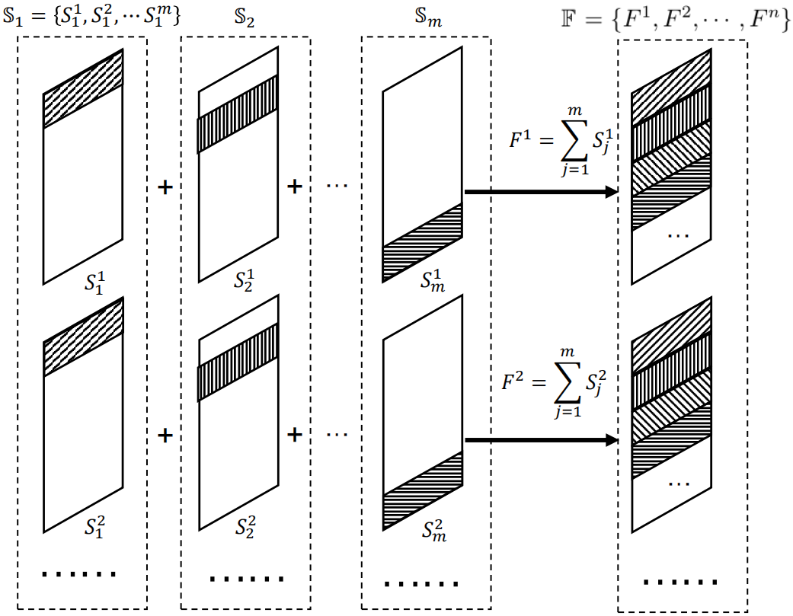
2.2 Related Works-Video Stabilization
There is an implied condition to use NCC or PCE to obtain an estimate of PRNU, i.e., all the images and frames involved should be aligned with each other.
Each video frame is reversely transformed according to the sensor-recorded information. Because the shakiness of the camera varies with time, each frame undergoes different global or local geometric transformations
Notes:
2) Nowadays most smartphones have an in-camera video stabilization system (VSS for short) to count for or compensate for the undesired movements of the camera during video capturing
3)Each video frame is reversely transformed according to the sensor-recorded information. Because the shakiness of the camera varies with time, each frame undergoes different geometric transformations.

Slide 8
2.3 Summing PRNU Up Cannot Obtain Good Result
Theorem 1. The expectation of PRNU directly extracted from a stabilized video is a linear combination of PRNU each of which is a geometrical transformation from K(F0)
The PRNU extracted from a sequence of frames K(F) is a linear combination depending on the probability distribution of geometrical transformations performed on the frames
We cannot guarantee a reliable result of video CDI by matching the reference and the test PRNU unless they both are extracted from video sequences long enough to incorporate a sufficient quantity of identical geometrical transformations
Given the difficulty of estimating the distribution of geometrical transformations, accurately predicting the requisite number of frames for obtaining a dependable PRNU is a challenging task
Notes:
Firstly, let's introduce the network structure of the video watermarking scheme based on the channel spatial attention mechanism.
The main components of the network structure include an encoder, decoder, and noise layer. The encoder is for watermark embedding. The decoder is for watermark extraction. The noise laryer is to mimic the possible operations on watermarked video to improve robustness

Slide 9
CONTENTS
1
Research Background
2
Related works
3
Effect of Video Stabilization
4
Proposed Aglorithm
5
Experimental Results
6
Conclusion
Notes:
My report mainly consists of the above six parts:

Slide 10
3.1 CDI strategies based on PRNU extraction from video
The following two strategies, I1 and I2, are applicable to CDI of an input test video when an image set I is available to extract a reference PRNU K(I)
I1: T denotes a frame set picked from the test video for extracting a test PRNU K(T). CDI is determined by observing the similarity between KT and KR which can be calculated by correlation coefficient ρ(K(I),K(T))
I2: A sequence of test residue is extracted from each frame of a given test video (with all frames denoted by T). And then match the residue sequence with the reference PRNU one by one, and the largest NCC is taken as the similarity measure, mathematically, MAXF∈Tρ(K(I)⋅F,W).
Notes:
The watermark information transformation module primarily transforms binary watermark information into dimensions identical to those of the video frames, facilitating watermark embedding.

Slide 11

3.2 Expectation of NCC with strategy I2
Theorem 2. Let K(I) be the reference PRNU extracted from a set of images, and F be a set of test frames possibly transformed for video stabilization. The expectation of the NCC associated with strategy I2 satisfies the following inequality,
where n is number of the frames in a video sequence, and P(F0) represents the probability that a video has a frame not transformed.
Theorem 2 shows that the local and global transformations have a similar effect on strategy I2. This is not intuitive because the local transformation usually makes the misalignment of PRNU more complex in comparison with the global one. Besides, we note that the performance of strategy I2 relates to the number of video frames.

Slide 12
CONTENTS
1
Research Background
2
Related works
3
Effect of Video Stabilization
4
Proposed Aglorithm
5
Experimental Results
6
Conclusion
Notes:
My report mainly consists of the above six parts:

Slide 13
4.1 Registration is not a good approach
The performance of strategy I2 can be improved further by a registration process
PRNU registration is likely to provide us with a variety of transformed test PRNU to match with a reference
We can obtain hundreds of frames from a few seconds of video. Every frame is with different geometrical transformations. It is possible to attenuate the effect of video stabilization to make full use of all these frames.
Notes:
.However, an accurate registration result is difficult to achieve, especially for a random signal like PRNU. The aforementioned prior arts tend to use 5–10 keyframes from a test video as long as an acceptable CDI result is obtained

Slide 14
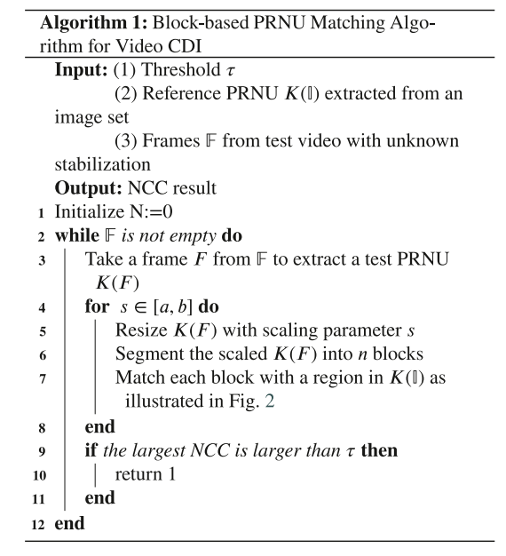
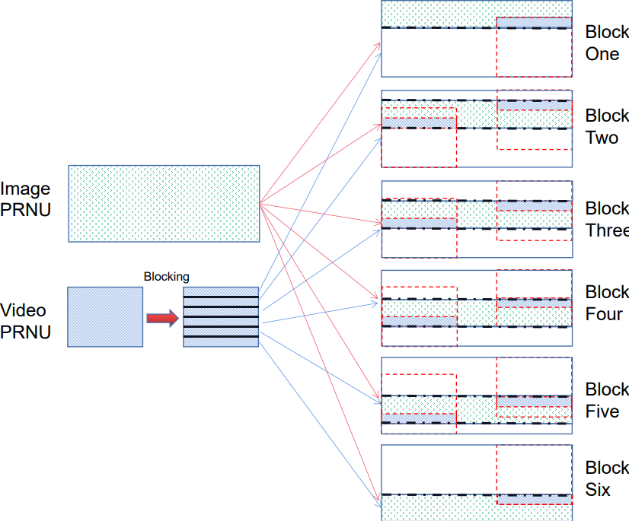
4.2 Proposed block-based algorithm
Notes:
.However, an accurate
registration result is difficult to achieve, especially for a random signal
like PRNU. The aforementioned prior arts tend to use 5–10 keyframes
from a test video as long as an acceptable CDI result is obtained

Slide 15
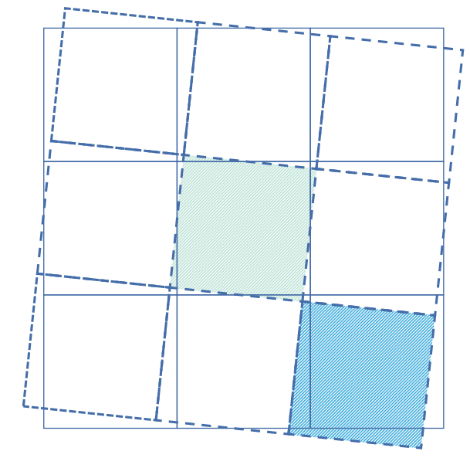
4.3 Advantage of the proposed algorithm
We partly exclude rotation from matching for registration
Dividing a PRNU into blocks can enlarge the number of probes
Notes:
Video CDI can benefit from our proposed block-based matching algorithm in the following two aspects. First, w

Slide 16
CONTENTS
1
Research Background
2
Related works
3
Effect of Video Stabilization
4
Proposed Aglorithm
5
Experimental Results
6
Conclusion
Notes:
My report mainly consists of the above six parts:

Slide 17
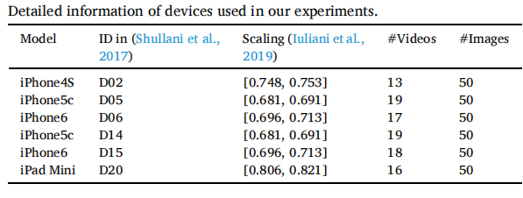
5.1 Experiments setup
We employ six Apple devices from the VISION dataset to verify our analysis and the proposed algorithm
Notes:
Video CDI can benefit from our proposed block-based matching algorithm in the following two aspects. First, w

Slide 18
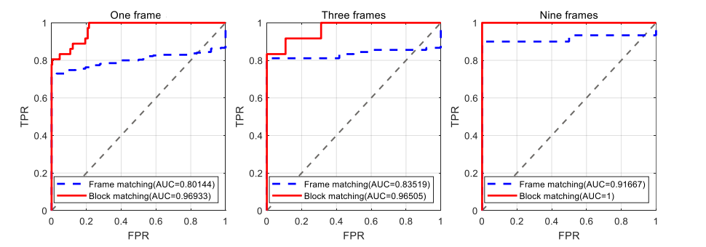
5.2 Performance of comparison test (move)
Notes:
Video CDI can benefit from our proposed block-based matching algorithm in the following two aspects. First, w

Slide 19
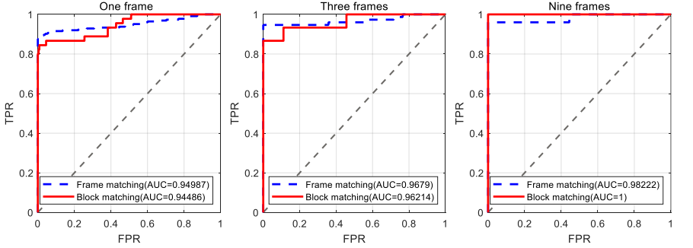
5.2 Performance of comparison test (still)
Notes:
Video CDI can benefit from our proposed block-based matching algorithm in the following two aspects. First, w

Slide 20
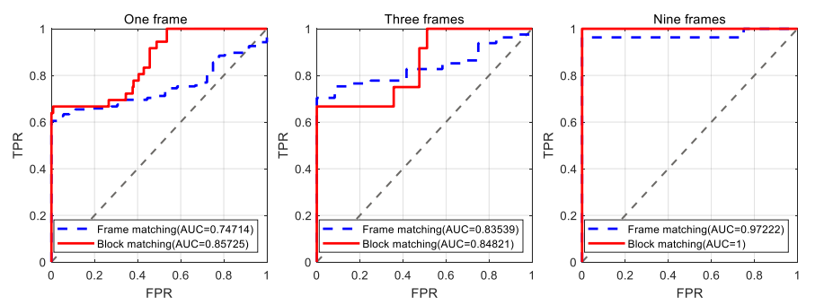
5.2 Performance of comparison test (panrot)
Notes:
Video CDI can benefit from our proposed block-based matching algorithm in the following two aspects. First, w

Slide 21
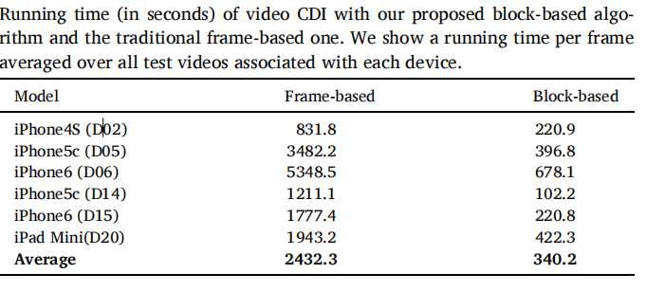
5.3 Performance of running time
Notes:
Video CDI can benefit from our proposed block-based matching algorithm in the following two aspects. First, w

Slide 22
CONTENTS
1
Research Background
2
Related works
3
Effect of Video Stabilization
4
Proposed Aglorithm
5
Experimental Results
6
Conclusion

Slide 23
6 Conclusion
We analyze the effect of video stabilization on CDI when the I2 strategy is employed for PRNU extraction. The results show that there is a linear relationship between the number of test video frames
and the expectation of NCC.
Based on the analysis results, we propose a block-based matching
algorithm for video CDI. Because the proposed algorithm effectively
enlarges the number of matches between test PRNU and reference
PRNU, the performance of the video CDI is remarkably improved
when a test video has a limited number of frames.

Slide 24
Thanks For Listening
Repoter：Jian Li
Notes:
The above is my paper report this time, thank you for listening

